Slide 1
AGM 22nd November 2023
To support
Bath and North East Somerset Council
employees

Slide 2
BATH & NORTH EAST SOMERSET SPORTS AND SOCIAL CLUB AGM AGENDA
Welcome
Agenda
Minutes from the previous AGM/Newsletter/Web pages
Who are your current committee members?
Membership figures and fees
Keeping active
What shows and trips have been arranged this year
What's coming up
Treasurer’s report
Summary of the Treasurer’s report
Report from the clubs
Election of Officers and other committee members
Could you support?
Joining the team
A big thanks
Open to questions.
Close meeting

Slide 3
Previous minutes
AGM 17 November 2022
New newsletter
Web pages
https://www.bathnessocialclub.co.uk/
Helpful links and information

Slide 4
Current officers and committee
Marie Bushby – Chair
Kate Hobson – Treasurer
Kellie Farnham - Membership Officer
Debbie Stevenson - Secretary
Andy Cox - Honorary Auditor
Dan Obi - Web updates / Communications Officer
Alison Sherwin - Committee member
Susan Boulton - Committee member
Give thanks to Michelle Fillary who did our Web updates for many years.

Slide 5
Our fees are £1.50 per month
Our membership figures are -
2021
We had -
418 paying members
221 retired members
2022
We have -
405 paying members
226 retired members
2023
We have -
416 paying members
231 retired members

Slide 6
Keeping active Gym memberships organised by Debbie Stevenson Football organised by Dan Obi Cricket club organised by Andy Cox
In 2022/2023 we have already supported.
Gym membership October 22 to September 2023 – 43 GLL members
Gym membership April 23 to March 2024
– 48 GLL members
At Dragonfly in Writhlington Social Club members can join at any point in the year for the corporate price of £300 pa, they just need a letter to confirm membership – 11 letters have been requested since November 2022
Five Aside football (please contact Dan for more information)
Cricket Club (please contact Andy for more information)
That’s 102 people being active.

Slide 7
Theatre Royal Shows organised by Kate Hobson
Girl from the North Country, Fisherman's Friends, The Mousetrap
Best Exotic Marigold Hotel, Aladdin, Relatively Speaking, Pride & Prejudice (sort of)
Lavender Hill Mob, Steel Magnolias, Noughts & Crosses
Ocean at the end of the Lane, Buddy Holly Story, Farm Hall, An Inspector Calls
Heathers, Shawshank Redemption, The Verdict, The Time Machine
Of Mice & Men, The Way Old Friends Do, Roman Holiday
Stumped, Tony – Rock Opera, Frank & Percy, 2:22 Ghost Story and
Voyage Round My Father
Bristol Hippodrome
Shows organised by Marie and the team
Cinderella (Panto 2022)
Sister Act
Fisherman's Friend
Bodyguard
Shrek the Musical
Charlie and Chocolate Factory
Annie
Pretty Woman
Birmingham shopping trip November 2022 London trip March 2023
Weekends away organised by Sue and Kellie
607 members took 329 non-members to shows throughout 2022/23, that's 936 of you seeing a shows or trips.

Slide 8
Future shows and trips arranged
Bristol Hippodrome (please note all booking now closed for these)
Panto (Peter Pan)
Hamilton
Wicked
Aladdin 25th July 2024 (booking form live)
Theatre Royal (please note all booking now closed for these)
The Score,
The Quiz, Cirque, The Forum
Sleeping Beauty, Theatre Royal
Buffy Revamped, I'm sorry Prime Minister
The Collection / The Lover, Drop the Dead Donkey
The Full Monty, The Circle
Sleuth, And then there were None
Calendar Girls, Kite Runner
Bonnie& Clyde, Cluedo 2
Theatre Royal Bath operatic and dramatic society BODS
9 to 5 The Musical (booking form live)
Bouncers (booking form live)
Sherlock Holmes (booking form live)
If any of the Sports and Social club members would like to arrange a show or a trip, please do contact us, we will always support you arranging the trip and don't forget you get a little discount!

Slide 9
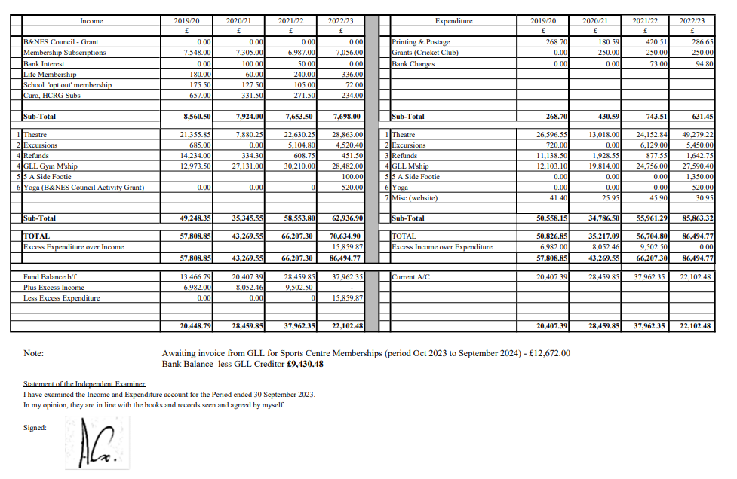
Audited accounts 2022/23 (now available to see on the Social Club website)

Slide 10
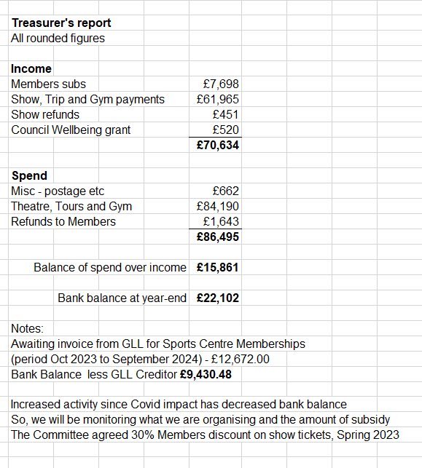
Treasurer’s summary report for 2022/23

Slide 11
Cricket Club report

Slide 12
Election of Officers and other Committee staff for 2023 / 24 Voted in by a show of hands
Chair - Marie Bushby ?
Treasurer – Opening - Kate Hobson can support until February 2024.
Membership Officer - Kellie Farnham?
Communications Officer – Dan Obi?
Secretary – Debbie Stevenson?
Web updates – Dan Obi?
Honorary Auditor - Andy Cox ?
Your committee members
Alison Sherwin
Susan Boulton

Slide 13
Treasurer
We are looking for a new treasurer because Kate, our current treasurer, will be leaving in February 2024. Because everything is run via Excel, a basic understanding of the excel would be very helpful.
Could you contribute 3 - 4 hours per month in addition to attending the monthly Committee meetings?
Complete training and handover will be provided.
The committee want to offer our heartfelt gratitude to Kate. Kate joined the committee in 2016 and then took over the treasurer role in 2020.
Kate will be sorely missed.

Slide 14
Meetings
We meet the third Thursday of every month from 12:15 to 13:00 via TEAMS.
If anyone would like to join us on the committee please do get in contact - Social_Club@BATHNES.GOV.UK , you are more than welcome.
Our AGM is held in November each year.

Slide 15
With thanks
I'd want to express my gratitude to all of the team and committee members; the club couldn't function without you, and it's always a pleasure to see you each month.
Also, a huge thank you to Andy for auditing our accounts yearly.

Slide 16
Open to questions ?

Slide 17
Thank you for taking the time to join us at our 2023 AGM.
The team wish you good health and
seasons greetings to you all.

